Slide 1
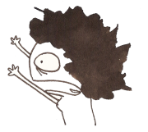
well, I’m not here.

Slide 2
but “mr. snowden” is!

Slide 3
dylan is a close friend.
we went to high school together!

Slide 4
he can give you great feedback on your work today.

Slide 5
today, you’re going to be working on the story we talked about on tuesday.

Slide 6
your story can be true, or it can be made up. remember the “glasses” story.

Slide 7
(if you don’t remember, it’s taped to the wall by the door.)

Slide 8
anyway, it’s important that you pay special attention to panel composition and page layout.

Slide 9
If you weren’t here on monday or tuesday, ask someone to give you an example of what that looks like.

Slide 10
here are a few examples of creative page layout:

Slide 11
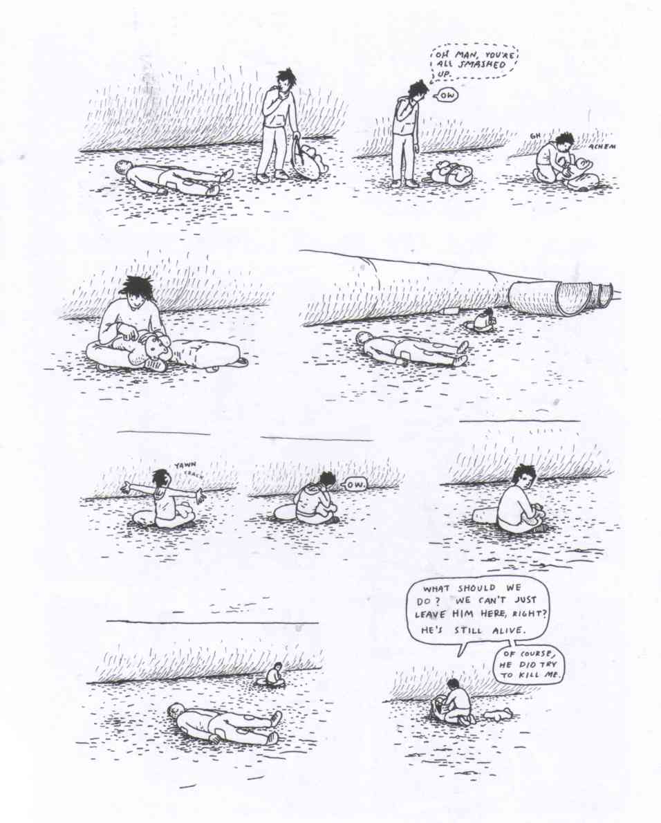

Slide 12
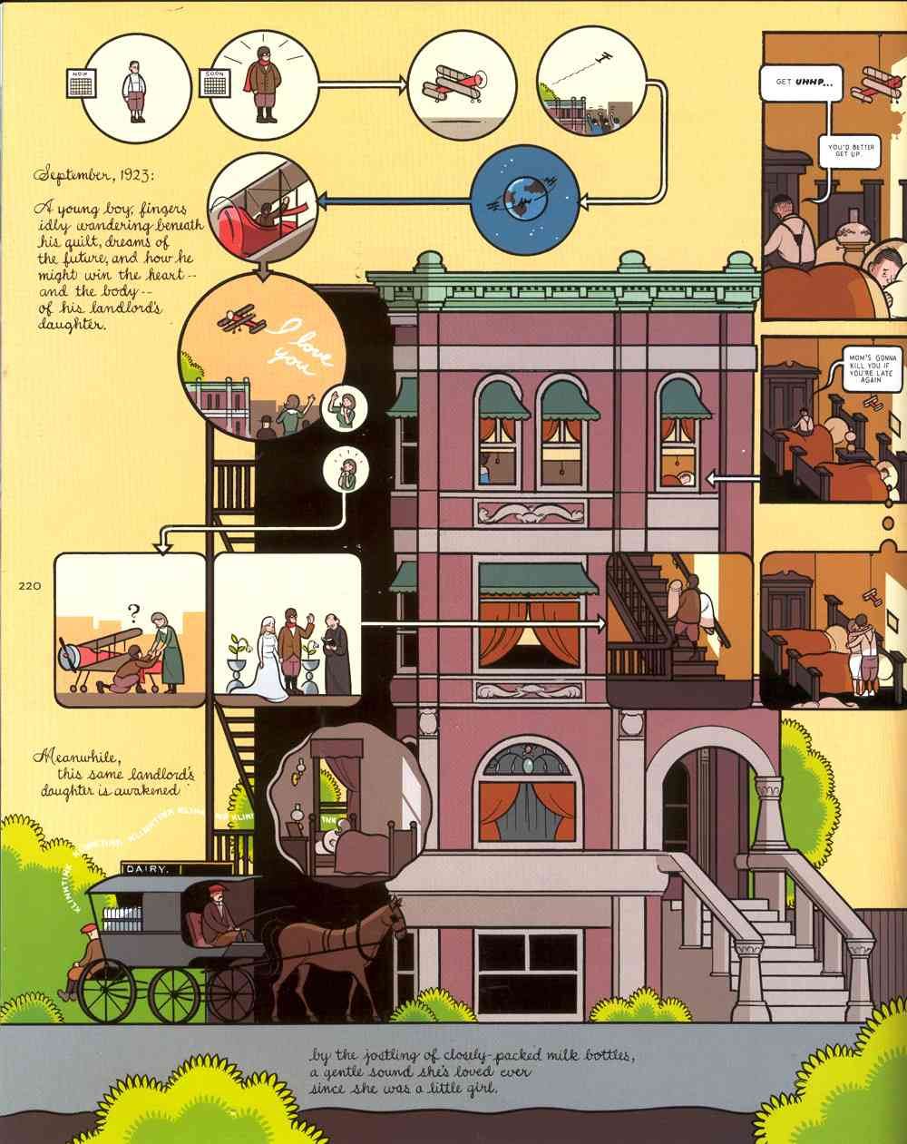

Slide 13
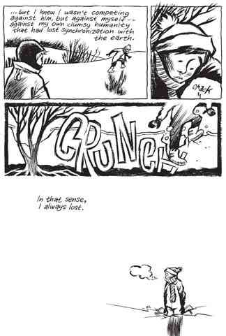

Slide 14
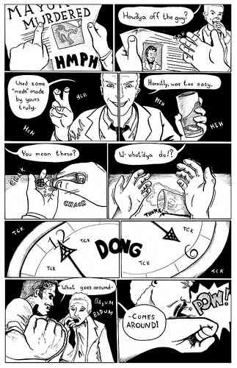

Slide 15
or, take a look at anything in the “library” (comics on the bookshelf) for other examples.

Slide 16
this project should take you 2-3 hours to complete.

Slide 17
you’ll work on it today and tomorrow in class, and it’s due on monday.

Slide 18
finally,

Slide 19
one more thing:

Slide 20
have fun!

